Slide 1


ArcGIS API for JavaScript An Introduction
Kelly Hutchins
Heather Gonzago

Slide 2

Outline
Setup
First Steps
Working with layers
Symbols and Renderers
Make your map interactive
Widgets and styling
Notes:
How many work in the API?
JS developers?
Geography majors?

Slide 3
Presentations accessible on GitHub
Focusing on version 4.0 for this presentation
Concepts are similar between 3.x and 4.0
Version 3.x UC 2015 presentation and demos are available
https://github.com/Esri/uc-2106-JSAPI-introduction
Notes:
Explain that we were uncertain which version to go with but with the release of 4.0 and more development efforts going that direction, we decided it was in the best interest to use this version. Provide link to all slides and demos so people can access this after this session.

Slide 4
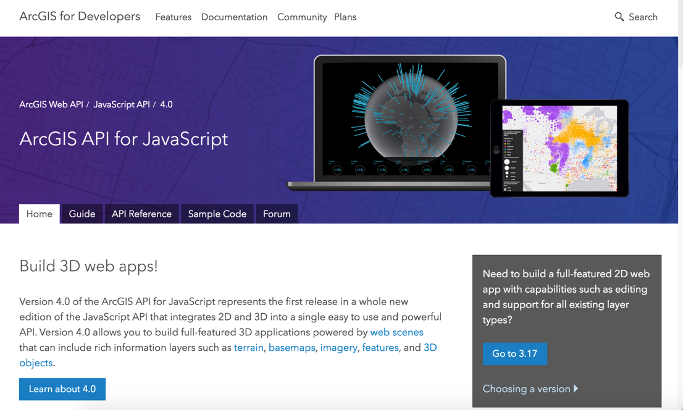
Where to begin?
https://developers.arcgis.com/javascript
Notes:
This should be the first place you should go if you are making the move from 3.x to 4.0 as it addresses what specific functionality is currently available in each version.

Slide 5
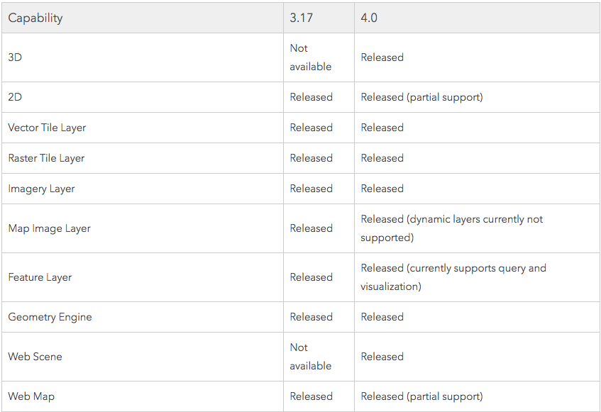
Which API version should I use?
Notes:
This should be the first place you should go if you are making the move from 3.x to 4.0 as it addresses what specific functionality is currently available in each version.

Slide 6
Developer Setup
Choose an IDE
Code assist
Helpful tools
Notes:
Kelly starts here
Lots of IDE options available from bare-bones tools like Notepad++ or Sublime text to full featured tools like Web Storm. Some options are Visual Studio Code, Sublime, Atom, Brackets and more.
Most of these environments have add-ins available to help simplify common tasks like working with gihtub, prettifying your code, linting and much more.
Github repo for JSAPI point out typescript and jshint
https://github.com/Esri/jsapi-resources

Slide 7
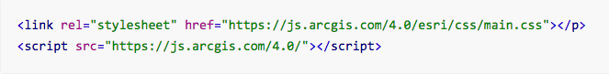
Get the API
CDN
Custom builds
Download API
Notes:
Multiple ways to access the api. The most popular way is to access the api via the hosted CDN. Bower is a good option if you’d like to generate a custom build of the API and finally the downloaded version is a good option if you’d need to host the api yourself – for example if you are working in a restricted environment with no internet access.

Slide 8
JSAPI-Resources
Collection of resources to aid development in the JSAPI
Some of these include:
JSHint file
Helps to detect errors and potential problems in code
Typescript definition file
Provides code assist in some IDE’s such as WebStorm and Visual Studio
Build tools, e.g. Bower for custom builds of the API
Callback page for popups using OAuth2 for security
Notes:
We provide some resources to help make developing a bit easier. Most of these resources are what are developers on the API use themselves.
For example, we provide a jshint file that you can download and use to help detect errors or potential problems in your code. There may be certain warnings that you receive but do not care about, you can open this file and modify it to your specific needs.
We also provide a TypeScript definition file. This file provides code assist in some IDE’s. One thing to point out is that many IDE’s that may not specifically support working with TS files still have their own form of code assistance or ’smart’ typing.
There are build tools provided that help to create your own custom local build of the JSAPI using Bower.
And lastly, we provide a sample callback page which can be downloaded and used if working with Oauth for security. This page would be needed if used with an Oauth signin popup page.

Slide 9
CSS
Main.css
Contains styles for all of API.
View.css
Better choice, if only need CSS for a basic map with default widgets. Smaller in size.
Custom css (sass)
Provide widget css source
Notes:
There are a couple different ways to style your JS API application using CSS.
At the very highest level, you can reference the main.css file which contains every single style within the API. This is much simpler since you don’t need to comb through and figure out what is needed, but it is bigger in size and does have that element of overhead.
The View.css is another option to reference if you are only needing the very basics. This is a lightweight version of what we provide in our API and is good if not needing to go above and beyond with styling customizations.
Lastly, you can create your own custom CSS build. We provide tools that help with this in addition to the source for all of our widgets’ CSS.

Slide 10
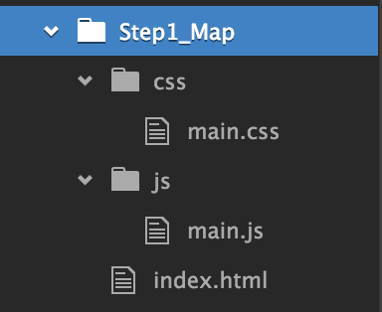
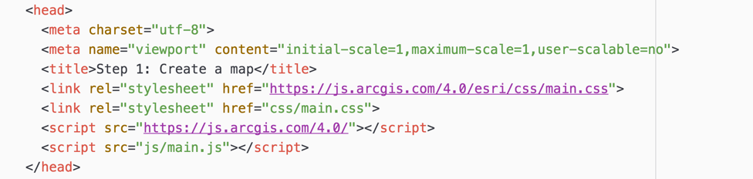
First steps
How will application be written?
Separate files or one combined file?
Demos shows separate HTML, CSS, and JS files
Reference JSAPI and any additional references, e.g. CSS, any other libraries in markup

Slide 11
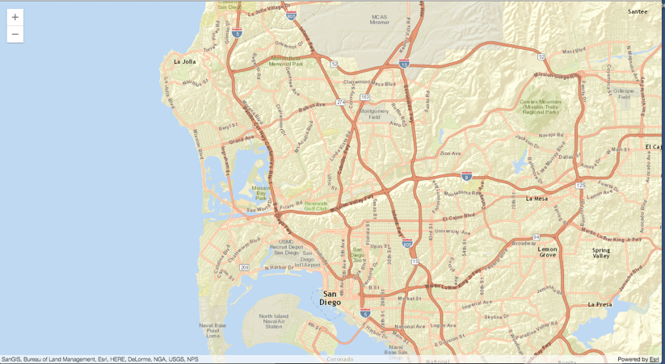
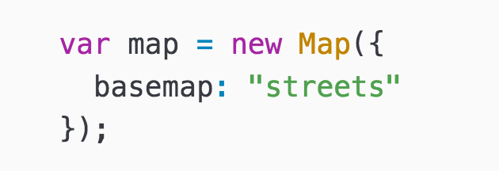
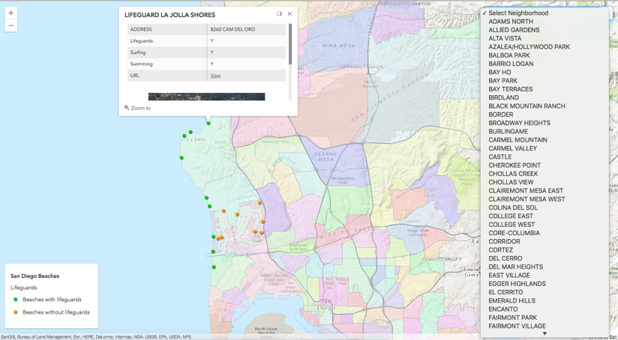
Make a map
Notes:
Kelly
During this session we’ll walk you through the process of creating a sample app and you’ll learn how to add data, make the map interactive work with events and widgets, symbolize your features and more.
Point out Map class in help and show module you need to load
Look at constructor options
Create simple map in our code file

Slide 12
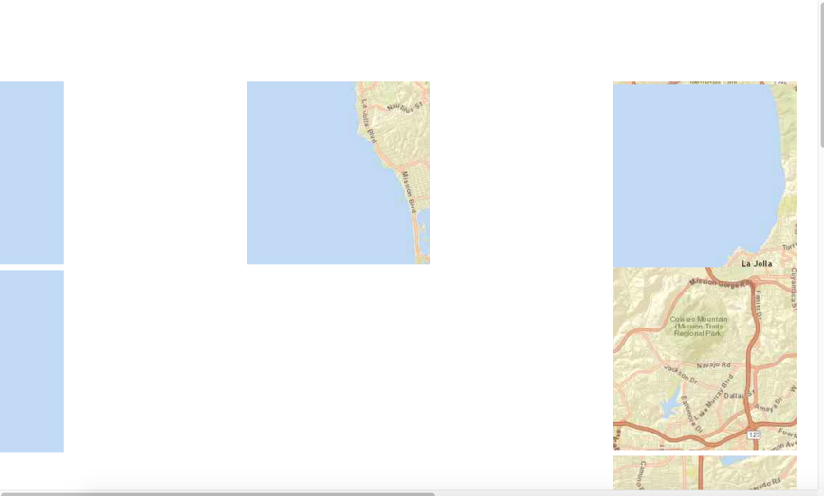
Tip
Modules out of order
Blank tiles -> Can’t find CSS
Notes:
Show a couple things that can happen when running your application, missing tiles, modules out of order, etc.
Possibly open console tab and show error message.

Slide 13
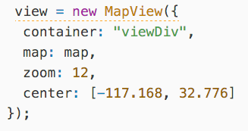
Map View
Notes:
Look at map view and explain relationship between map and map view. Point out the same logic for scene and scene view.
Views are used specifically to visualize the data within your map or scene. A map contains the actual data or layers to display, whereas the view handles displaying this data. How this data is visualized, or displayed, varies depending on whether you're working in 2D or 3D. The view has a reference to the map, e.g. view.map. But the map does not have a reference to the view. It is important to note that a single map can be consumed by multiple views.
Here's another way to think of this: the map describes the basemap and features in the world, whereas the view is the window to that map that allows it to be viewed.

Slide 14
Add layers
Layer types
FeatureLayer
MapImageLayer
ImageryLayer
TileLayer
VectorTileLayer
GroupLayer
SceneLayer
… and more
Notes:
Heather takes over here

Slide 15
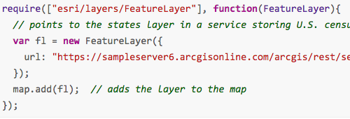
Layer coding pattern
Load module
Create layer
Set properties
Add to map (or scene)
Notes:
Regardless of what type of layer you are using, the basic coding pattern remains the same.
First, Load the module. If you aren’t sure exactly where it resides, go to the API reference to see it’s location
Second, create the actual layer, e.g. “New ….layer”
Third, specify any properties for that layer, for example do you want to set
Lastly, add the layer to the map (or scene)

Slide 16
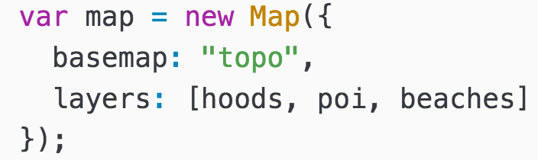
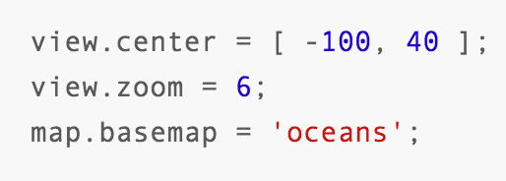
Working with Properties
All properties for each class can be set in its constructor
No need to explicitly call Get/Set for properties
Watch for property changes
Use esri/core/watchUtils to aid in watching property changes
Notes:
Can now watch for property changes and act upon them. This is much more fine-grained than simply listening for some events to happen.

Slide 17
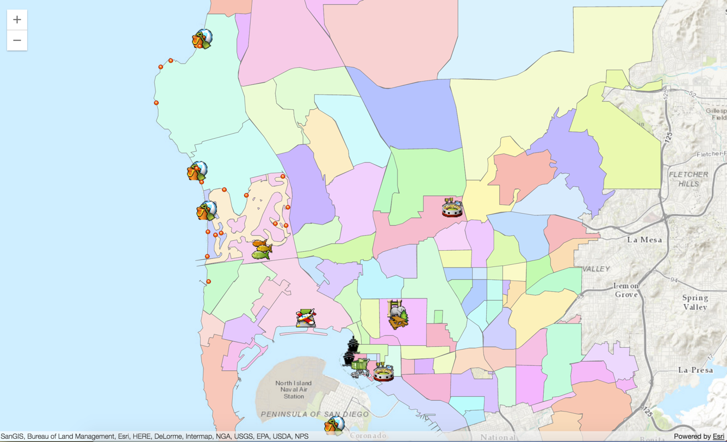
Demo: Add layer to sample app
Notes:
Open sample and look at code
Add a new layer to map
Show that I’m adding an array of layers, all featurelayers, two point one polygon

Slide 18
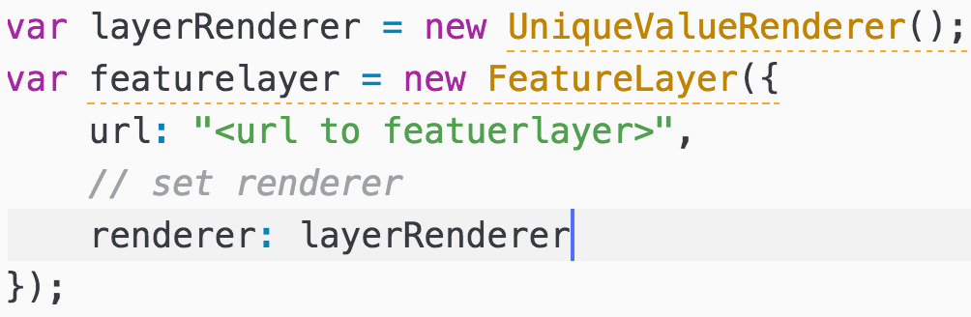
Renderers
Define a set of symbols to use for the layer
Set rules on how the symbols should be used
Basic coding pattern
Notes:
Renderers help specify how you wish to represent the layer.
Libraries that help display information on the map, you apply the renderer once, no matter the amount of features. The renderer will loop through all the features and apply and symbology to them.
There are various types, such as uniquevaluerenderer, classbreaks, simple renderer, heatmap is coming as well.

Slide 19
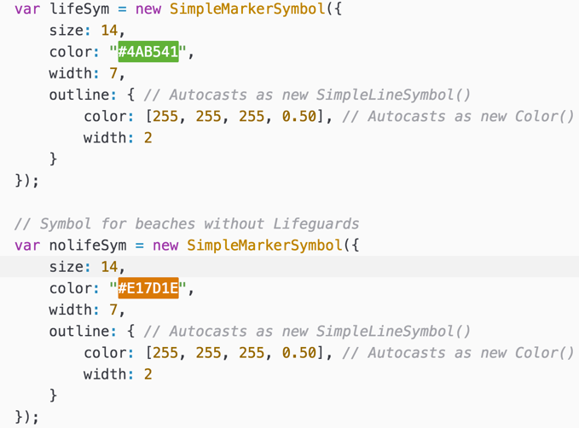
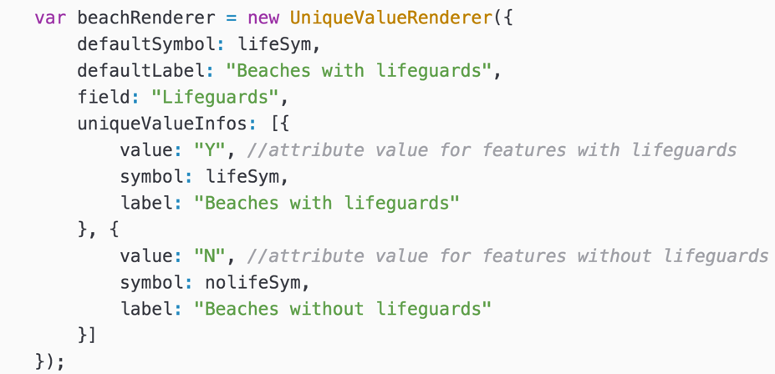
Symbols
Renderers make use of symbology
Points, lines, and polygons
Pass the symbol to the renderer
Notes:
Can have more control on how the renderer should display the data.

Slide 20

Autocasting
Allows you to pass in a property without having to specifically require it in the code.
Efficient
Less code
Less overhead
Not sure if a property can use this functionality?
Check property’s API reference for Autocast label
Notes:
https://developers.arcgis.com/javascript/latest/guide/autocasting/index.html

Slide 21
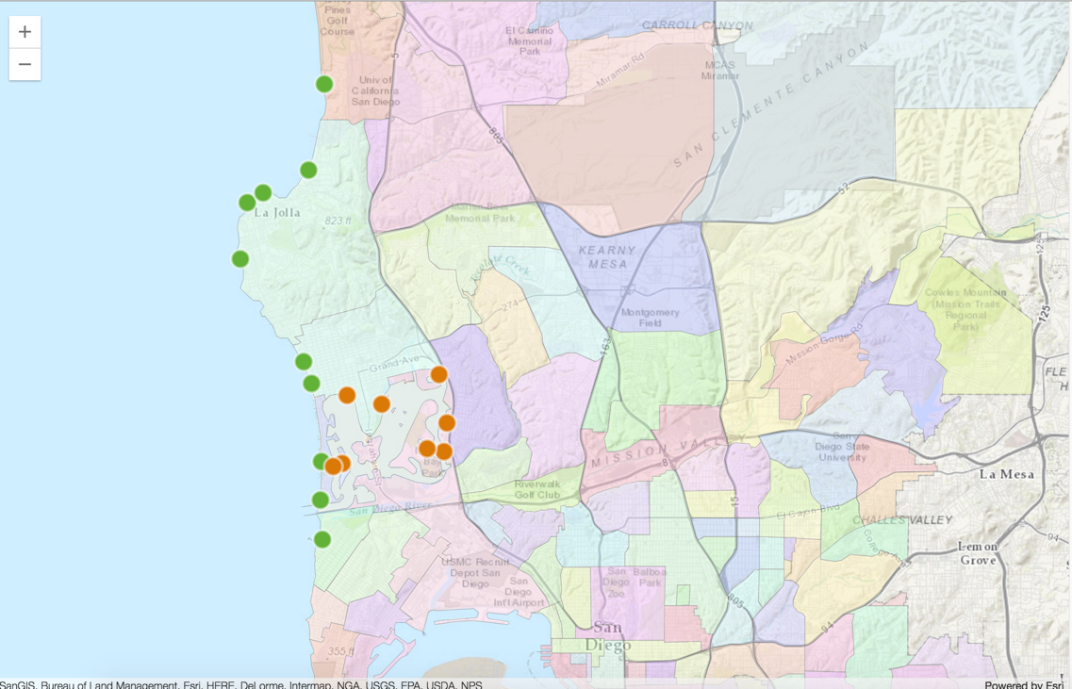
Demo: Update feature layer renderer

Slide 22
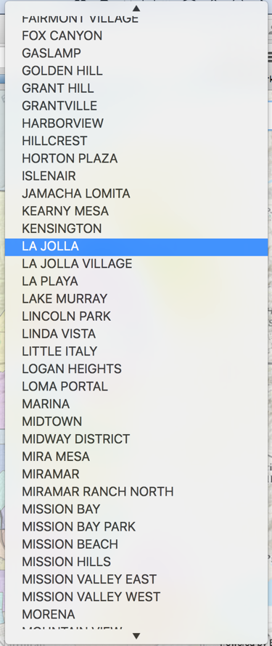
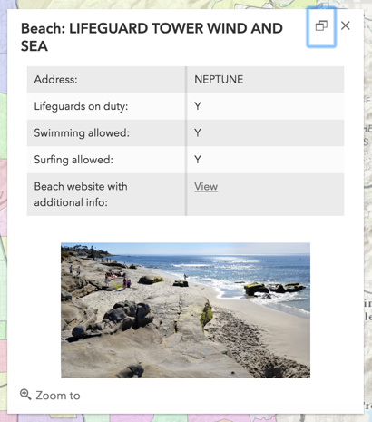
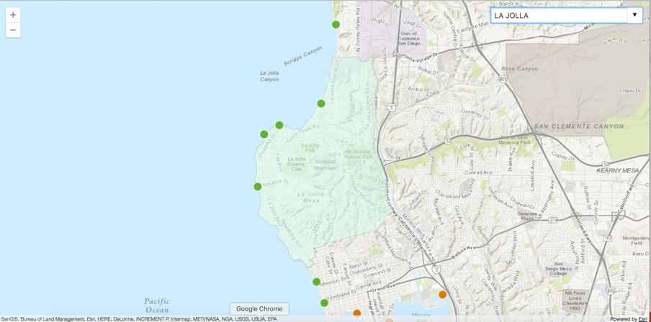
Interactive Map
Make map interactive
Popups
Query
Filter out features based on a definition expression

Slide 23
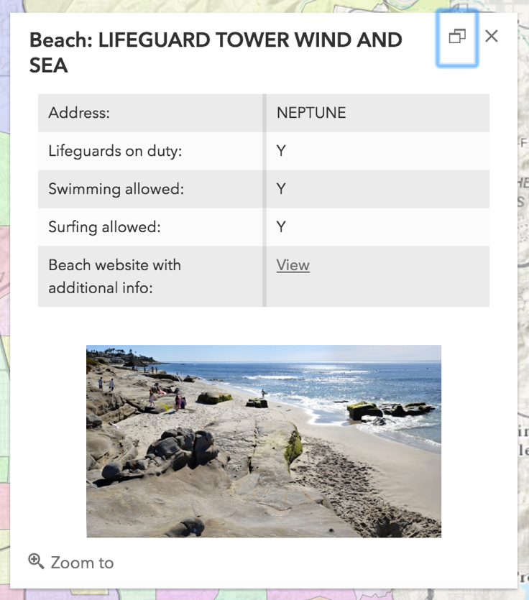
Popups
Responsive widget
Information about
Clicked location
Feature
Search results
Customizable
Notes:
Add popups to simple app – popup template for feature layer
Show a few help samples too including one that shows how to add a custom action.

Slide 24
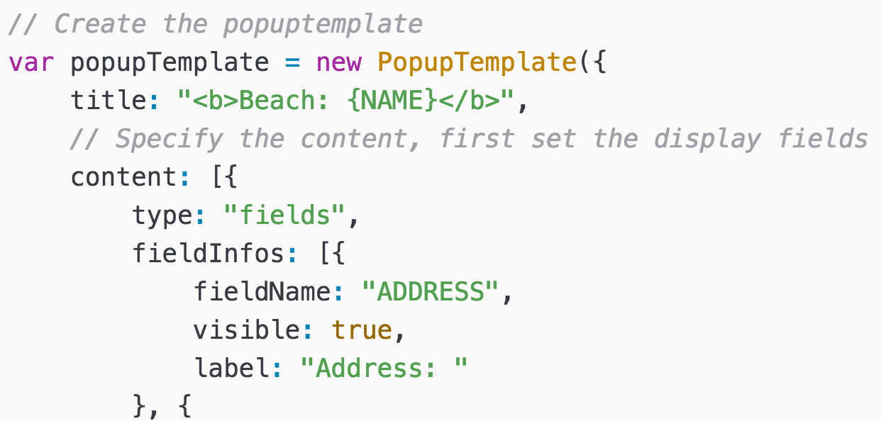
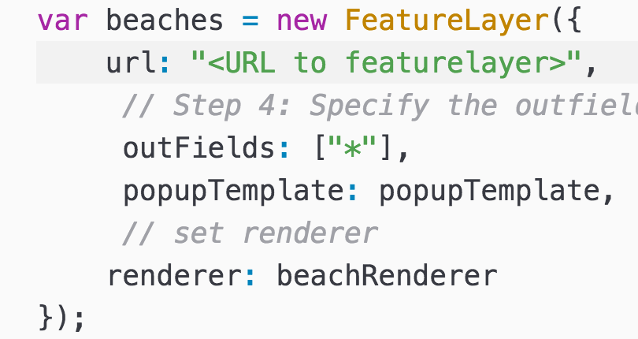
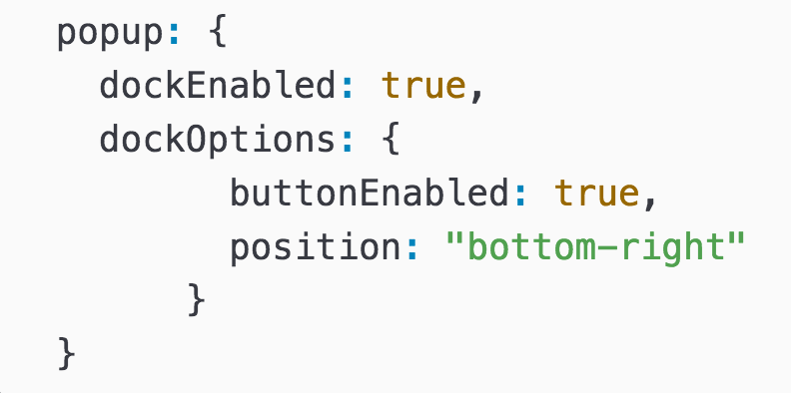
FeatureLayer PopupTemplate
View has associated popup
Popup content is set via PopupTemplate
FeatureLayer has popupTemplate
Popup’s dockOptions
Notes:
Add popups to simple app – popup template for feature layer
Show a few help samples too including one that shows how to add a custom action.

Slide 25
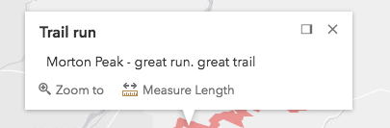
Popup: Custom Actions

Slide 26
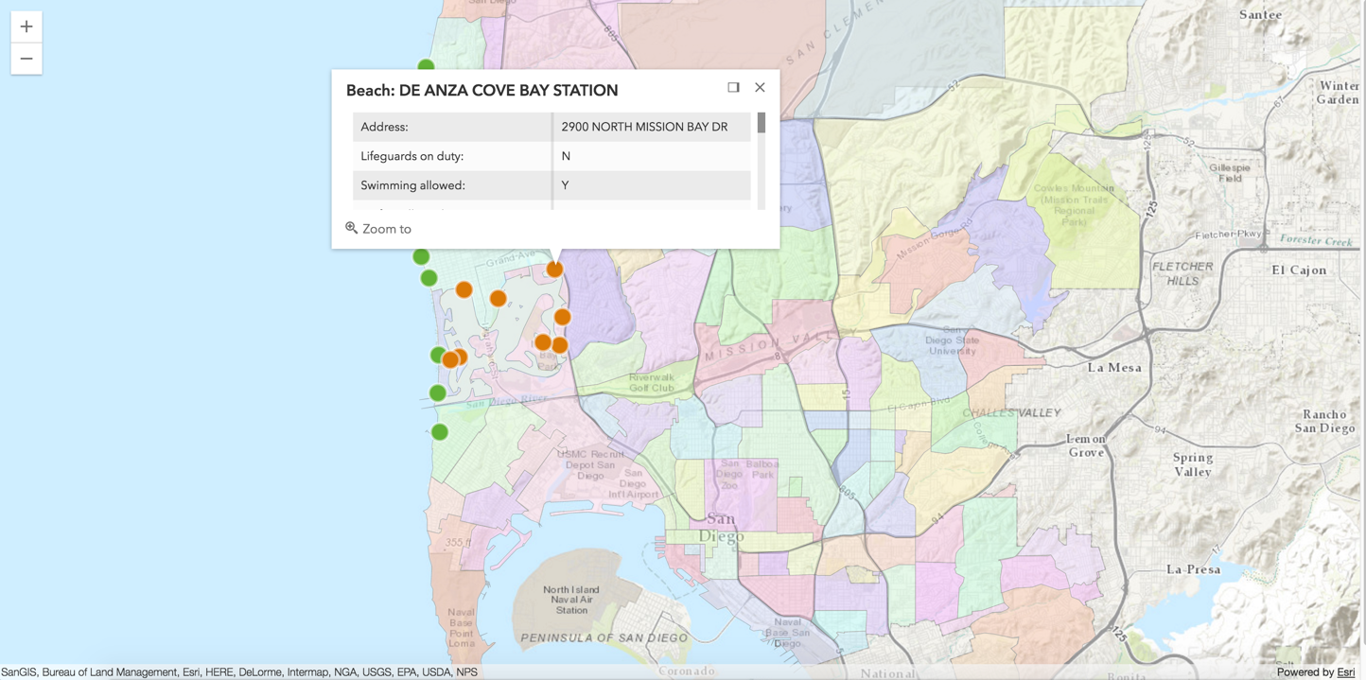
Demo: Add a popup to the map

Slide 27
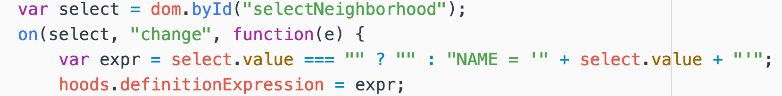
FeatureLayer definition expressions
SQL where clause used to filter features on the client
Use with large datasets
View automatically refreshes
Notes:
Kelly starts again here

Slide 28
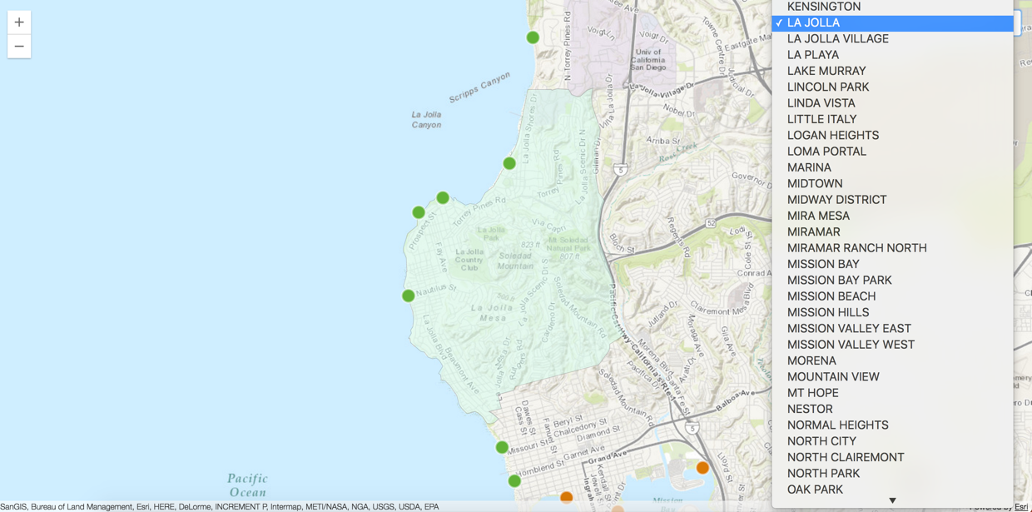
Demo: Filtering features using a definition expression

Slide 29
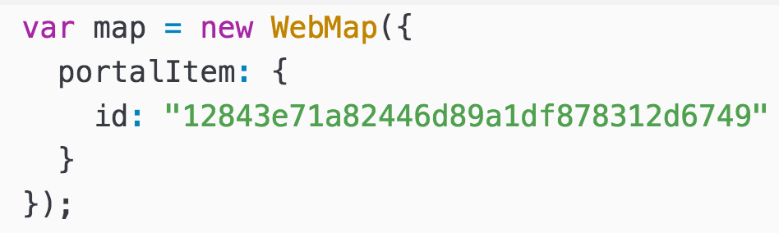
Web map
Reduce code by using a web map
No need to write a bunch of code
Retains all customizations with rendering, popups, filtering, etc.
Basemap
Layers
Popup
Symbology
Extent
Basemap
Notes:
Show web app that is same look as our demo app but uses createMap so its only a few lines of code to build app instead of all the code required to create a map, add layers ,define renderer, setup popup template etc.

Slide 30
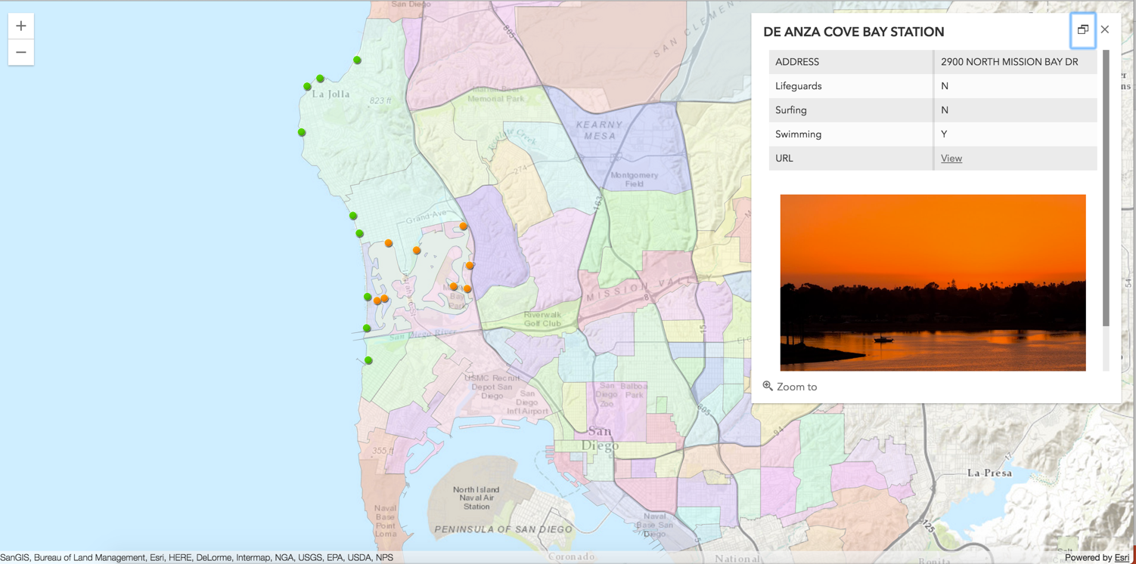
Demo: Add a web map to an application

Slide 31
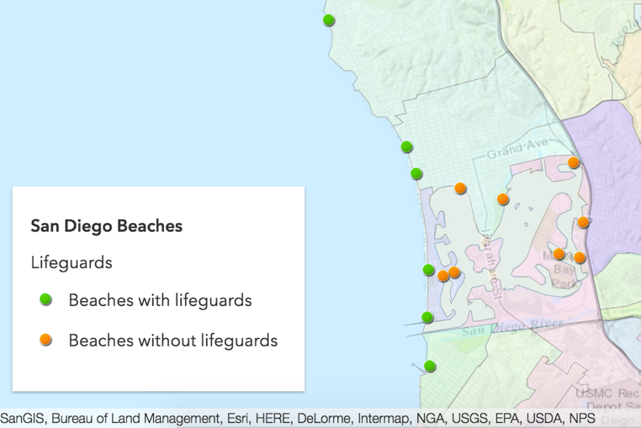
Widgets
Specific encapsulated functionality
BasemapToggle
Compass
Home
Legend
Search
Popup
Track
Locate
More to come

Slide 32
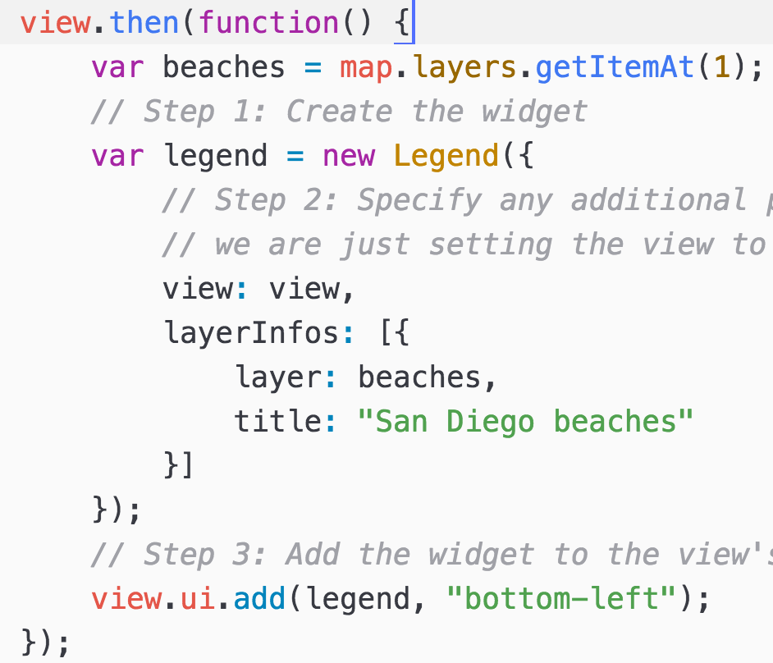
Widget coding pattern
Load module
Create widget
Set widget properties
Add widget to UI

Slide 33
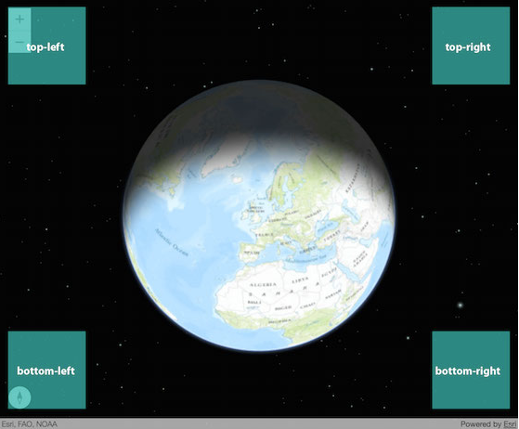
Default UI
Notes:
Show that you can easily add widgets to the views ui.

Slide 34
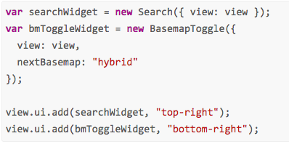
Widget coding pattern
Load module
Create widget
Set options
Add widget to the UI

Slide 35
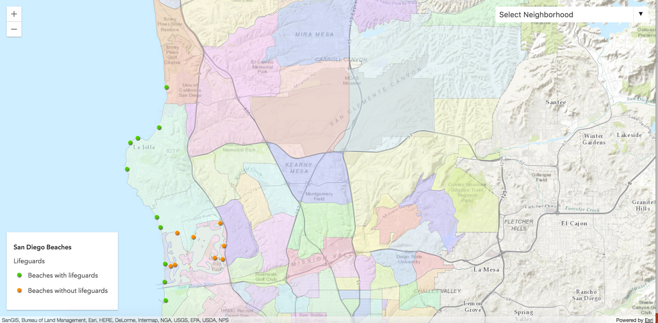
Demo: Add widget to app
Notes:
Add some widget to sample app (search, legend).

Slide 36
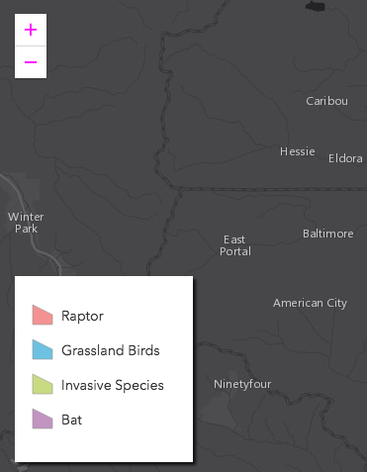
Customize widget appearance
CSS
SASS
Notes:
Make some simple changes to widget and point out sass doc
https://developers.arcgis.com/javascript/latest/guide/styling/index.html
Do something simple like show how to change zoom icon color, hide title and add a box shadow.

Slide 37
Want more info?
Documentation
https://developers.arcgis.com/javascript/
Dojo documentation
Check out Esri-related training classes and webinars
Additional Resources
JavaScript online training classes: free and fee-based
Notes:
Make some simple changes to widget and point out sass doc
https://developers.arcgis.com/javascript/latest/guide/styling/index.html
Do something simple like show how to change zoom icon color, hide title and add a box shadow.

Slide 38
Additional sessions
2D Visualization with the ArcGIS API for JavaScript
3D Visualization with the ArcGIS API for JavaScript
ArcGIS API 4.0 for JavaScript: Patterns and Best Practices
Road Ahead: ArcGIS API for JavaScript
ArcGIS API for JavaScript: What's New
Widgets 101: Customizing and Creating Widgets with the ArcGIS API for JavaScript
Notes:
Make some simple changes to widget and point out sass doc
https://developers.arcgis.com/javascript/latest/guide/styling/index.html
Do something simple like show how to change zoom icon color, hide title and add a box shadow.

Slide 39



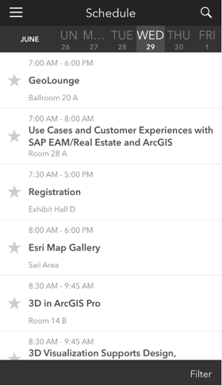
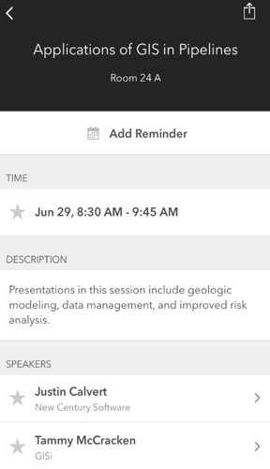
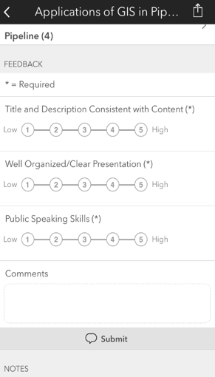
Please take our Survey
Your feedback allows us to help maintain high standards and to help presenters
Find your event in the Esri Events App
Find the session you want to review
Scroll down to the bottom of the session
Answer survey questions and submit

Slide 40


